Slide 1
Next-Gen IoT Botnets #3 Bad Implementations of Good Cloud Platforms
SBX1-W9
Alex “Jay” Balan
Chief Security Researcher
Bitdefender
abalan@bitdefender.com | @jaymzu

Slide 2
About us
IoT security research started in 2013 within Bitdefender Labs
Published about 15% of all our research due to slow vendor responses
Most recent published research – Ring doorbell, Belkin WeMo, Guardzilla (more at https://labs.bitdefender.com)
As of 3 years ago we started to focus more on IoT cloud platforms

Slide 3
IoT from a pentester’s perspective
IoTs are websites running on Linux but with a significantly bigger attack surface due to mobile apps & cloud

Slide 4
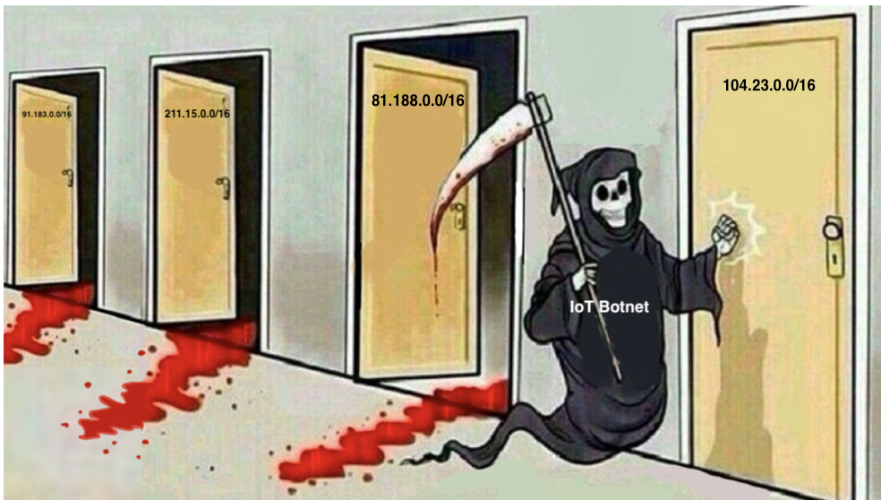
Traditional IoT & botnets

Slide 5


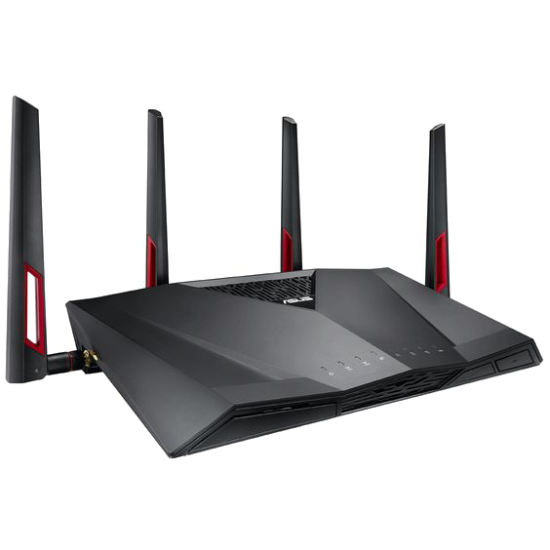
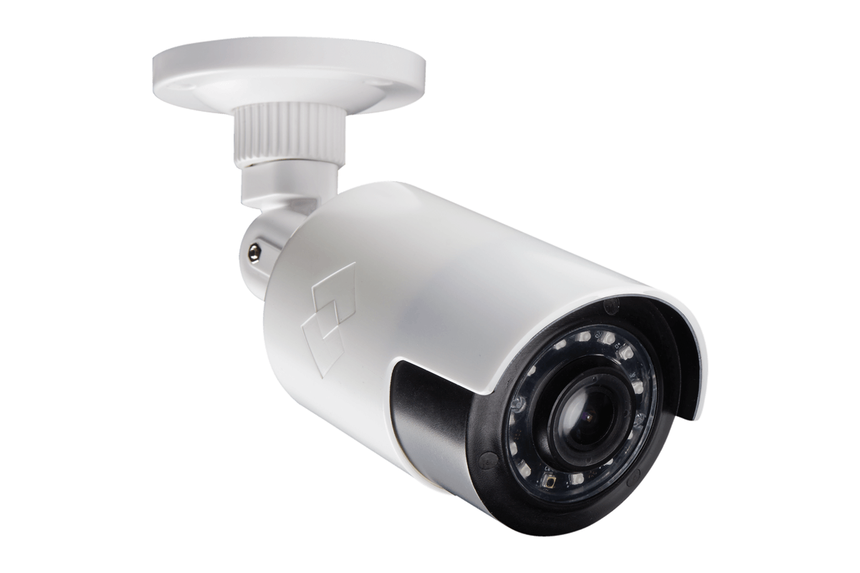
Today, IoT is cloud managed
Not directly accessible from the internet
More efficient management
Modular architecture. Components provided by 3rd parties
Unique 20 char Device_ID identifies each managed device
Communication and commands are sent by using Device_ID
Decent usage of encryption
This is a very very generic description but applies to 90% of cloud implementations for IoT
BLEMCN5YPUYTW595111A

Slide 6
But not all cloud implementations turn out great
In most of the cases there’s no actual authentication implemented.
Device_ID is considered unpredictable and serves as auth
Some vendors implement additional symmetric keys, unique per device. Thumbs up!
Some vendors implement additional functionality, quite often breaking what should be decent security
E.g. Amazon S3, MQTT, client_id, etc

Slide 7




But not all cloud implementations turn out great
That cloud looks like a giraffe
That one looks like a mushroom
Ref: http://explosm.net/shorts/347/cloud-watching

Slide 8
A few words on S3 buckets
S3 in many cases relies on “/this/is/the/path/to/the/file/you/want.mp4”. The path is generated by whatever device or app uploads the file and relayed to whoever needs to access it.
You can’t “ls /this/is/the/path/to/the/file/you/*” to see what other files are there
Did I say “you can’t?”. I meant you shouldn’t be able to
We’ve seen an alarming number of vendors allowing the equivalent of a recursive “ls –R /this/”

Slide 9
A few words on MQTT
The device registers to something like /vendor/device_id/topic where topic = types of events (online, offline, etc)
The management app is told “you can tap into /vendor/device_id/topic” to receive events and interact with the device
Security countermeasures prevent attackers from tapping into /vendor/another_device_id/topic
…when implemented properly
I’ve been told that you can sometimes register to /vendor/ and get swarmed with all the device_ids and their statuses

Slide 10


So we started sending notifications to vendors
DEVOPS
CISO
So… You know the cloud?
@!#$%#$@!@%$#!!!!!

Slide 11
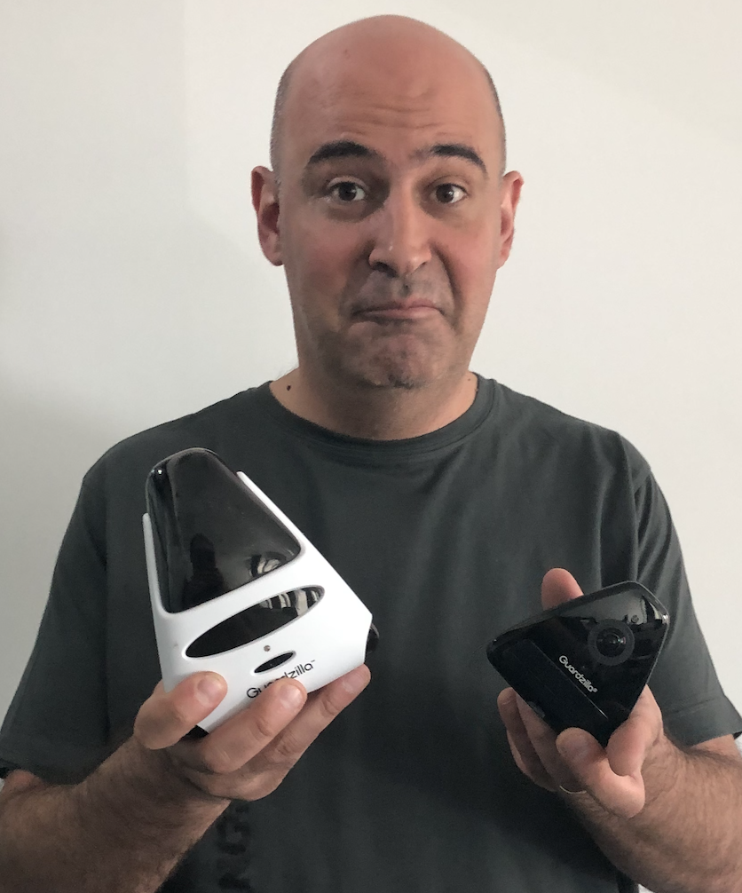
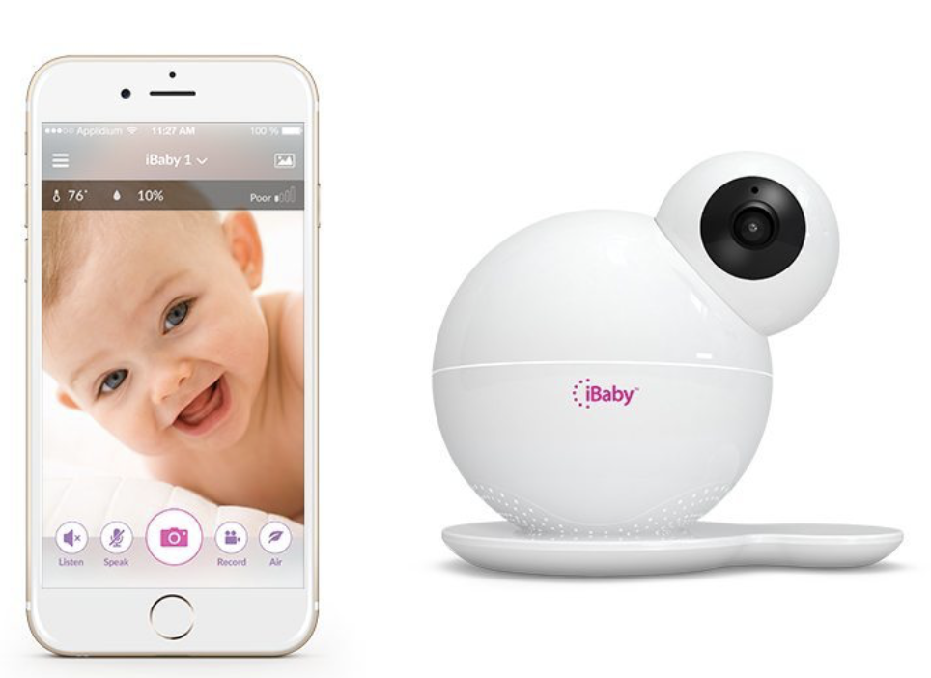
So many vulnerabilities! So little time!
Wyze Cam Pan
Guardzilla – Smart Security Camera
iBaby Monitor

Slide 12
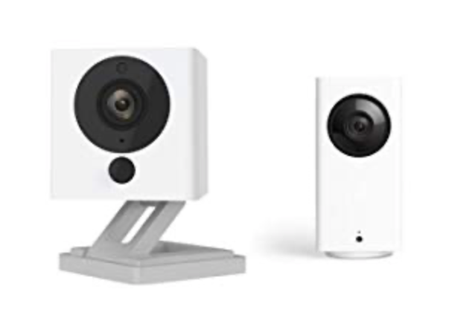
Wyze cam pan
A 20 char ID is used to communicate with the device via cloud or LAN
Secred shared based authentication
RCE from stack buffer overflow (CVE-2019-12266)
Auth bypass (CVE-2019-9564)
Unauthenticated access to SD card contents
Device ID can be acquired from LAN

Slide 13
Demo

Slide 14
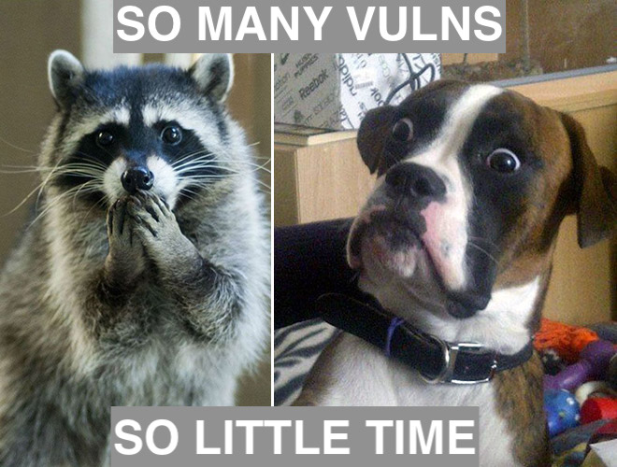

Slide 15
Guardzilla – Smart Security Camera
API endpoint at https://apps.guardzilla.com
After the first auth/account registration the app receives a 6 digits long UID (ours is 408311. Have phun!)
Can’t be changed
Incremented by 1 for each new account ☺
UID can be used to pull all the info for all the devices associated with that account, including user, pass, device ID
With Device ID, user, pass an attacker can interact with any device registered with the GuardZilla Cloud

Slide 16
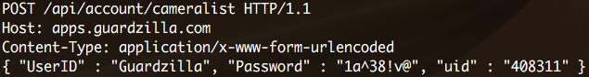
Mobile app behavior
UserID and Password are hardcoded
POST requests sent to the cloud are encrypted with AES256 CBC mode
Encryption key and IV hardcoded in the app
It’s actually a “client_id” they added for enhanced usability (more devices per user, for example)
We can now script-emulate the mobile app of any user

Slide 17
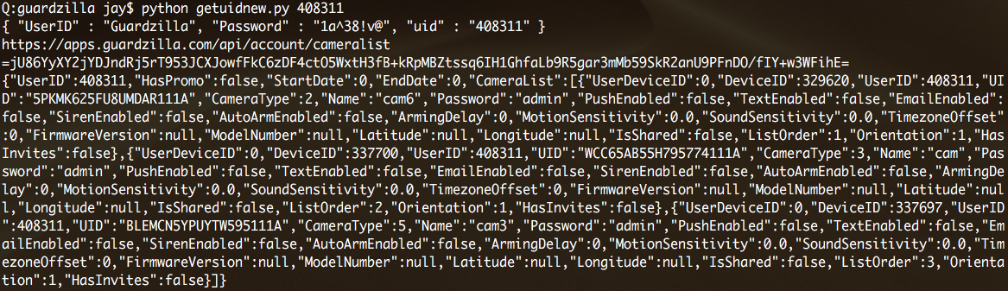
Fetching the info for our Client ID

Slide 18
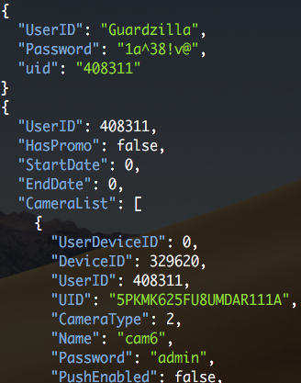
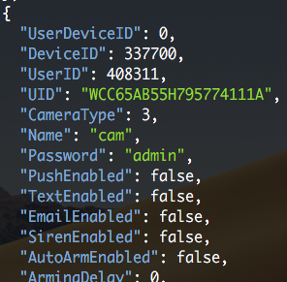
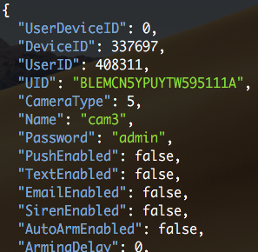
Fetching the info for our Client ID (jq’ed)
Useful information: device id (UID) and password
Worth mentioning that you can change that password (and some do) but it’ll be useless

Slide 19
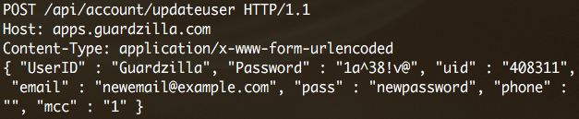


Account takeover
Full account takeover by changing e-mail and pass to arbitrary values
E-mail doesn’t have to be valid since no confirmation e-mail is sent
The old credentials will be invalidated

Slide 20
Accessing the audio/video feed – the hard way
Just for the hell of it we wrote a client that emulates the app and pipes the video feed to vlc
Takes device ID and password as parameters

Slide 21
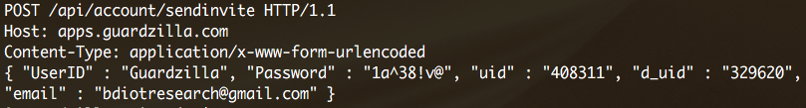
Access to the audio/video feed – the easy way
“sendinvite” API – requires uid and d_uid (obtained earlier)
Can be used to forge an invitation to view a specific camera
The owner is unaware that somebody else has access to the camera

Slide 22
Buffer overflow in the cloud agent - RCE
Kalay Platform (https://www.tutk.com/) used for cloud communication
A combination of P2P and relay servers used to bypass NAT restrictions
main.v5.1.4.exe handles a number of services, including cloud communication
Upon inspection, we identified a function vulnerable to out of bound writes: TK_set_deviceModel_req_handle
A specially crafted buffer sent over the cloud communication gets us RCE

Slide 23
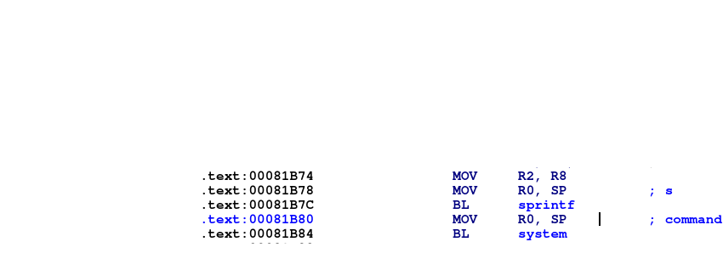
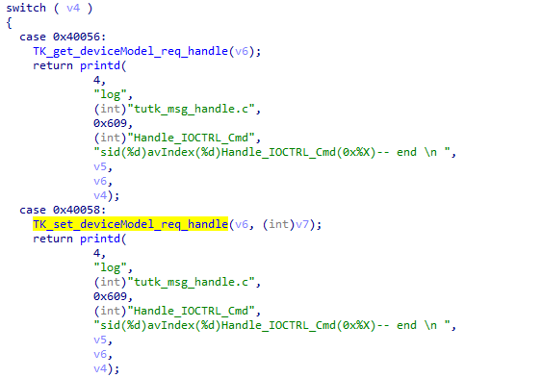
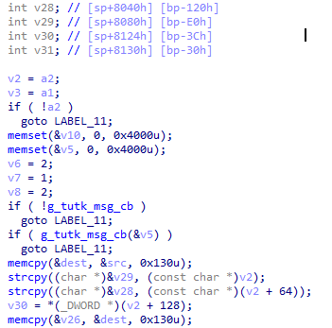
And call system
We overflow v28, then v29 and reach the return address below the stack frame

Slide 24
Calling system. Is anybody home?
The “almighty” exploit.
The function that sends the command through the cloud
Type of command that corresponds to the TK_set_deviceModel_req_handle function
Gadget address used to call system
The main binary will crash after the command is executed and the camera will restart. To achieve persistence we’ll append the commands to the camera’s startup script @ /mnt/mtd/startapp
Tested against GZ251W, firmware version 0.5.1.4. Other models may be affected

Slide 25
More RCE: command injection
GZ180 supports remote upgrade
The function takes 2 parameters: firmware version and download location
The firmware version will be concatenated to tar as an argument and then executed through the system command
The download location needs to be accessible (not valid)
Camera firmware will remain unaffected since there’s no valid upgrade and its workflow will continue uninterrupted but it won’t accept another upgrade command until reboot
Requires Device UID and password (obtained before)

Slide 26
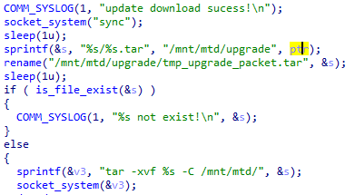
More RCE: command injection

Slide 27
AWS bucket access
The camera records short videos when the motion detection system is triggered and the camera is armed
Recordings are uploaded to an AWS bucket named motion-detection
One key pair is used for all cameras: AWSAccessKeyId and SecretAccessKey, retrievable from the device firmware
=> full read/write access to the AWS bucket
+ directory index

Slide 28


Slide 29
iBaby Monitor
Uses MQTT for management and S3 for storage
In most cases, S3 ”security” relies on 3rd parties not
knowing the path to a file.
E.g.: /root/$device_id/recordings/12.12.2019.15.20.21.mp4
File path is generated and relayed to whichever app needs to read it
MQTT aggregates events, also in a tree structure
E.g. Device registers to: /root/$device_id/$topic (where topic may be on,off, something detected or other types of events) on the MQTT server
App linked to $device_id receives the types of events it can read from the MQTT server

Slide 30
iBaby Monitor
We successfully listed the contents of the S3 buckets and registered for all the topics for the device_ids corresponding to our 2 purchased devices.
Both scenarios should not be allowed. Only specific full file paths and specific full paths to topics. As such there’s reason to believe access to the root of both S3 and MQTT may be accessible.
We didn’t try for legal reasons.
We couldn’t reach the vendors. Not for lack of trying.

Slide 31
Demo

Slide 32


Slide 33
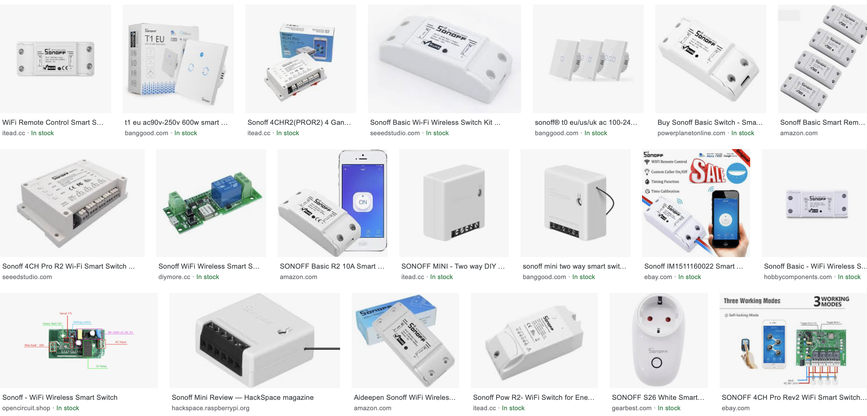
Sonoff/eWeLink platform
Small gadgets, including lightbulb sockets, power outlets or electronic relays, that can be remotely controlled

Slide 34
Sonoff/eWeLink platform
During the initial setup (registration) process the smartphone app will make an API request with the unique device ID and the auth token obtained at the initial login
The cloud checks the auth token and processes the request. It does not, however, check if the device ID is already registered to another account
As a result, all we need to do is make a request as a valid user with an arbitrary device ID and the servers will grant access to the full functionality of that device ID

Slide 35
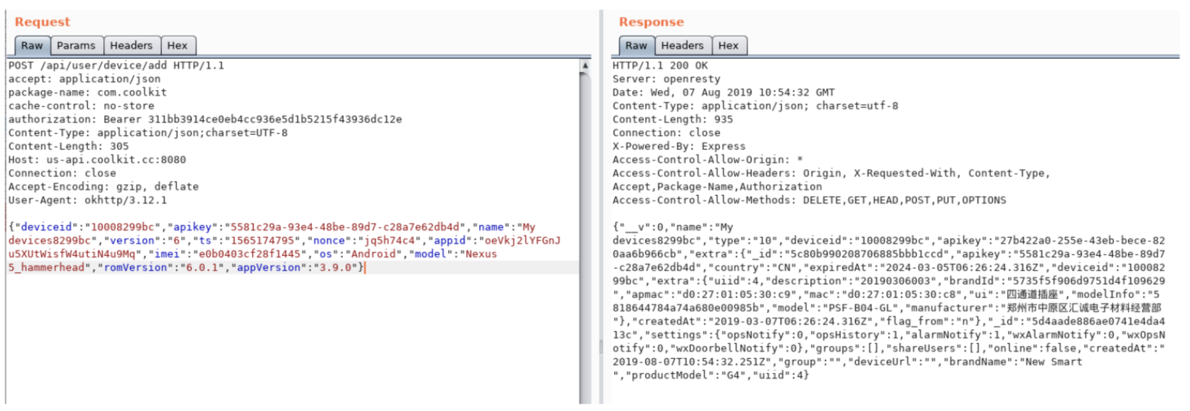
Sonoff/eWeLink platform

Slide 36
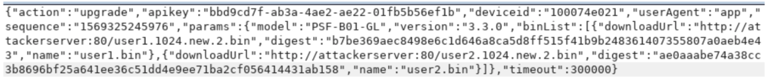
Sonoff/eWeLink platform
Interesting “side-find”: The devices we analyzed don’t check for firmware updates but rely on the app to tell them if there’s an update available and where to get it.
…which means we control every aspect of the update process, allowing us to send malicious updates sent from a server we control.

Slide 37
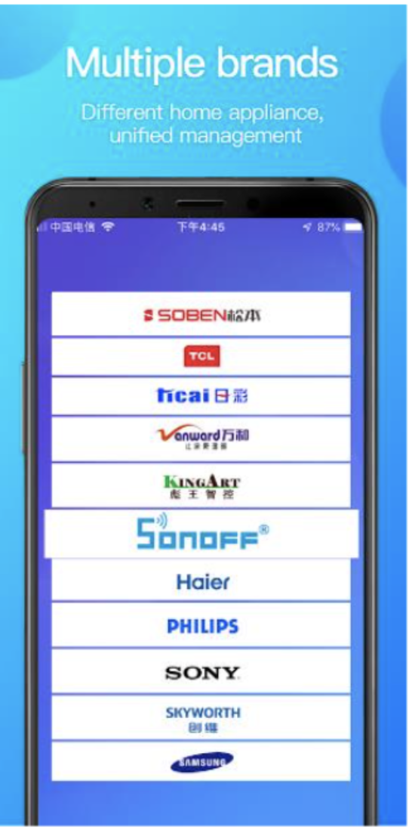
Sonoff/eWeLink platform – affected devices
The eWeLink platform is used by multiple manufacturers as listed in the screenshots from their App Store and Google Play pages
Though there are some big brands there we only found Sonoff devices that are supported available to buy (not to say others aren’t vulnerable)

Slide 38
Sonoff/eWeLink platform
Sonoff devices, developed by ITEAD use a 5 byte value for their unique ID
Out of those 5 bytes, the first 2 are used to define device type while the rest represent a random number
The entropy for that random number sucks, though as we discovered that all devices we tested used the same ID pattern
…making device ID easily brutforceable

Slide 39
Demo

Slide 40
Sonoff/eWeLink platform
Out of all the papers outlined here, this was the only case where we got a reply from the vendor
Vulnerability was confirmed and is now patched across the board.
Kudos to them for that!

Slide 41
End notes
We’ve been researching IoT for the better part of the last 4 years
Team exclusively allocated for this
In virtually 99.99% of the cases, if the vendor didn’t have a bug bounty program, the devices had critical vulns in their latest firmware versions
Our attempts to reach out to the vendors were ignored in the vast majority of the cases
More than half had RCE over the internet
It truly is a gift that keeps on giving

Slide 42
End notes
Cloud relayed attacks against IoTs will bypass all your countermeasures.
The traffic is encrypted and you can’t use your CA to do DPI
IP addresses used in communication are legitimate (the device’s cloud)
You won’t know about exposed recordings or other data without a thorough audit
A viable defense is detecting unusual access times and connect back shells/C&C communication (in case of a foothold/RCE) with a decent Network Traffic Analysis solution

Slide 43
End notes
Include IoTs in your security posture. This includes your IP phones, PBX, smart power outlets, etc
”Military grade encryption” provides zero security against the most common attacks today
Note that a large amount of identified issues can’t be tracked by CVE look-ups
Security audits (internal or outsourced) on all your smart devices. This includes SCADA and Industrial IoT
Purchase any device that supports connectivity only from trusted providers with reasonable SLAs.
Push for better standards and accountability from vendors

Slide 44

Thank you!
abalan@bitdefender.com | @jaymzu

